Slide 1
Cost Allocation within ERPs
Idle Use
March 2022

Slide 2
ERP Systems
Cost Allocation Goals/ Needs
Pros & Cons of Cost Allocation in ERP System
Idle Use
Square Footage
Questions & Discussion
Contact Information
March 2022

Slide 3
ERP Systems
“ERP is an acronym that stands for enterprise resource planning (ERP). It's a business process management software that manages and integrates a company's financials, supply chain, operations, commerce, reporting, manufacturing, and human resource activities.” (Microsoft definition)
Systems may be used across agencies or separate ERPs may be implemented at individual agencies
Requirements for systems may be statewide or individualized

Slide 4
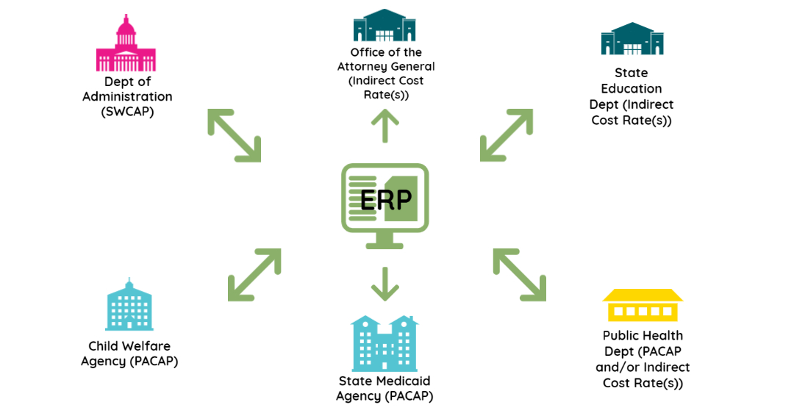
ERP Systems
Cost allocation is an integral fiscal function and required by federal oversight agencies to receive reimbursement for indirect and administrative costs
Many government entities attempt to conduct cost allocation within ERP systems
Cost allocation requirements/ regulations vary by type of entity

Slide 5
Cost Allocation Goals – Central Services/SWCAP

Slide 6
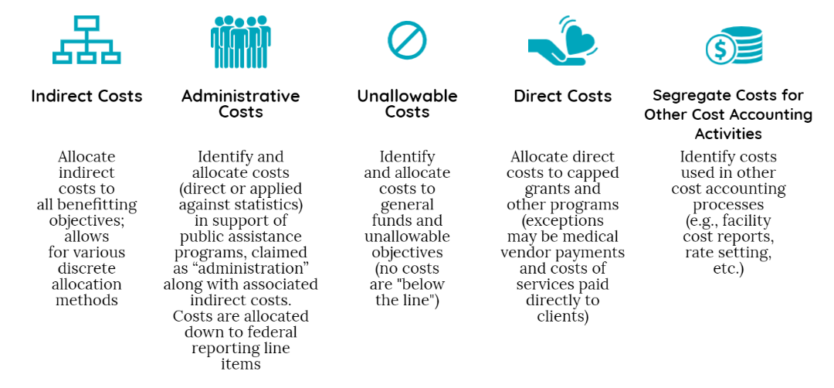
Cost Allocation Goals – Public Assistance Plans

Slide 7
Common Needs
Central Service/SWCAP
Public Assistance/Other
Calculated annually
Two Stepdown Methodology (usually)
Allocates central/indirect costs
Often uses data from prior periods (not live)
Usually calculated only once per period
Need for carryforward adjustments
Time tracking
Calculated quarterly
4+ Stepdown Methodology (usually)
Allocates all costs (including indirect costs)
Must use actual data for the current period
Often rerun more than once to support claiming efforts (e.g., prior period adjustments, etc.)
Commonly requires adjustments to cost data and cannot use “live” data
May require use of more detailed salary data to complete cost allocation
Time tracking

Slide 8
Pros and Cons
Pros
Cons
One system to manage
Streamlines cost collection
Supplemental reporting
Allows for multiple users at various points in the process
Reorganization of cost pools does not have to be managed in multiple processes
Generally, does not support multiple steps
May not allow for necessary statistics (especially for public assistance plans)
May not allow for adjustments/carry forward adjustments
Usually, cannot be re-run
Cannot support the records created for multiple stepdowns
May not comply with all 2 CFR Part 200 requirements necessitating additional adjustments
Requires customization (most ERPs do not have tools that are specific to government)
May not be integrated with time reporting/ tracking processes
Reports may not be what is required by federal oversight agencies
Different agencies are often dependent on others for processing times, data, etc.
An ERP may work for some cost allocation plans and not others

Slide 9
“idle facilities means completely unused facilities that are excess to the non-Federal entity’s current needs”
“idle capacity means the unused capacity of partially used facilities”
Generally, these costs are unallowable
Costs are allowed for a “reasonable period of time” and/or seasonality
Idle Use
2 CFR Part 200 §200.446 addresses idle facilities and idle capacity
Changes to facility use and the workforce due to the pandemic may impact compliance with 2 CFR Part 200
Agencies need to be mindful of changes and watch for guidance
Agencies may struggle with how to allocate costs as many of the costs still exist (e.g., buildings exist even if staff are working at home) and may for some time even if the agency has plans to change
Cost Savings from Work at Home and hybrid models may not outweigh the loss of statewide federal revenue (at least initially)

Slide 10
Square Footage
Many cost allocation plans and indirect cost rates use square footage statistics to allocate costs
For entities where staff have not returned to the office and/or are planning to remain remote and/or use hybrid staffing models, square footage may no longer be an appropriate method
Entities should review where square footage is utilized and identify alternate methodologies

Slide 11
Questions & Discussion

Slide 12
Contact Information
Amy Ferraro-Whitsett
Vice President
MGT
617.475.7344
awhitsett@mgtconsulting.com
Bret Schlyer
Vice President
MGT
614.382.2211
bschlyer@mgtconsulting.com

